Slide 1
Liang Yang UNV Assignment Sharing
AdaptaClima: Fortifying Climate Resilience in Ecuador's Coastal Cities through Empowering National Meteorological and Hydrological Services
A Collaborative Project between UNDP and INMAHI

Slide 2
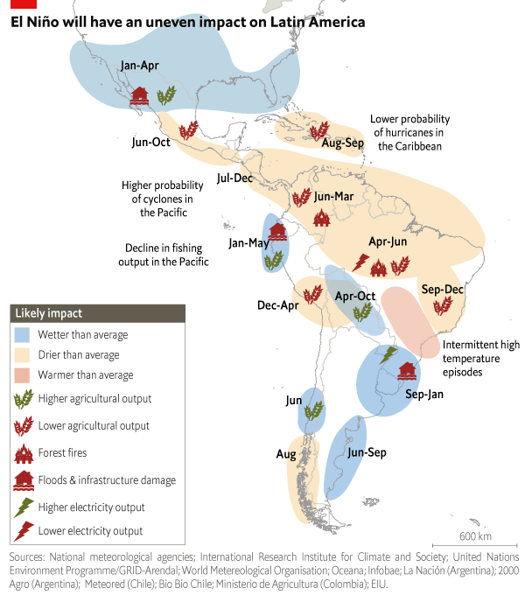
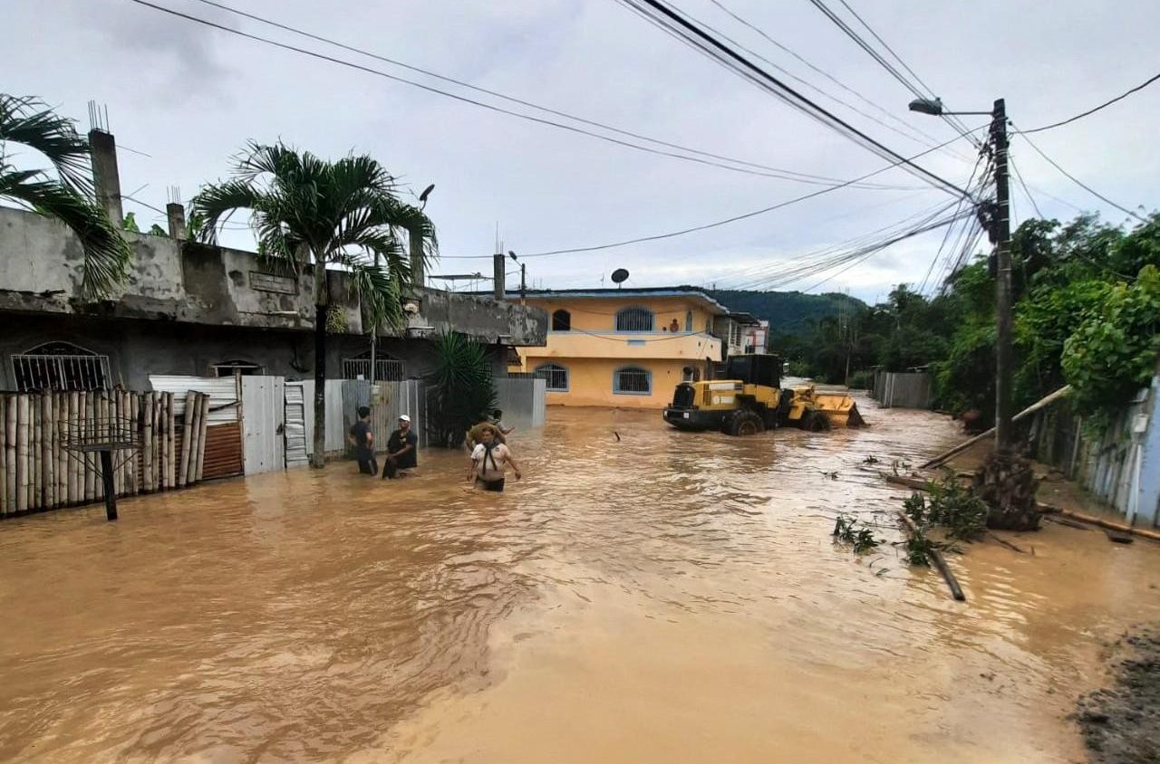
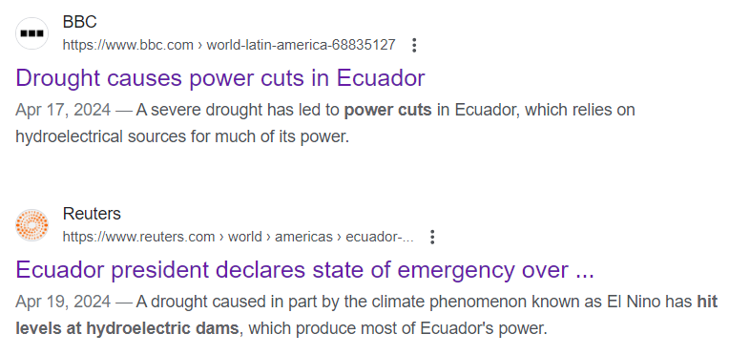
PROJECT BACKGROUND: Under the influence of El Niño, Ecuador is suffering with both droughts and floods
Floods in the costal provinces, especially the Esmeraldas city
Droughts causes energy crisis in the inland due to a high dependency on hydropower
Source: The Economist
Notes:
This project aims to Fortif Climate Resilience in Ecuador's Coastal Cities through Empowering National Meteorological and Hydrological Service.

Slide 3
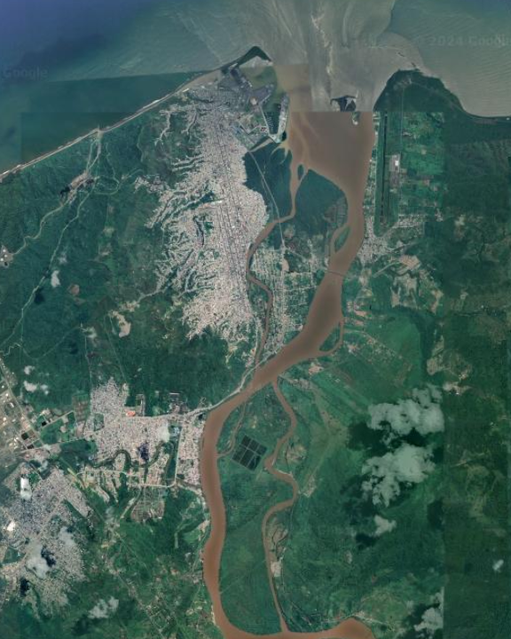
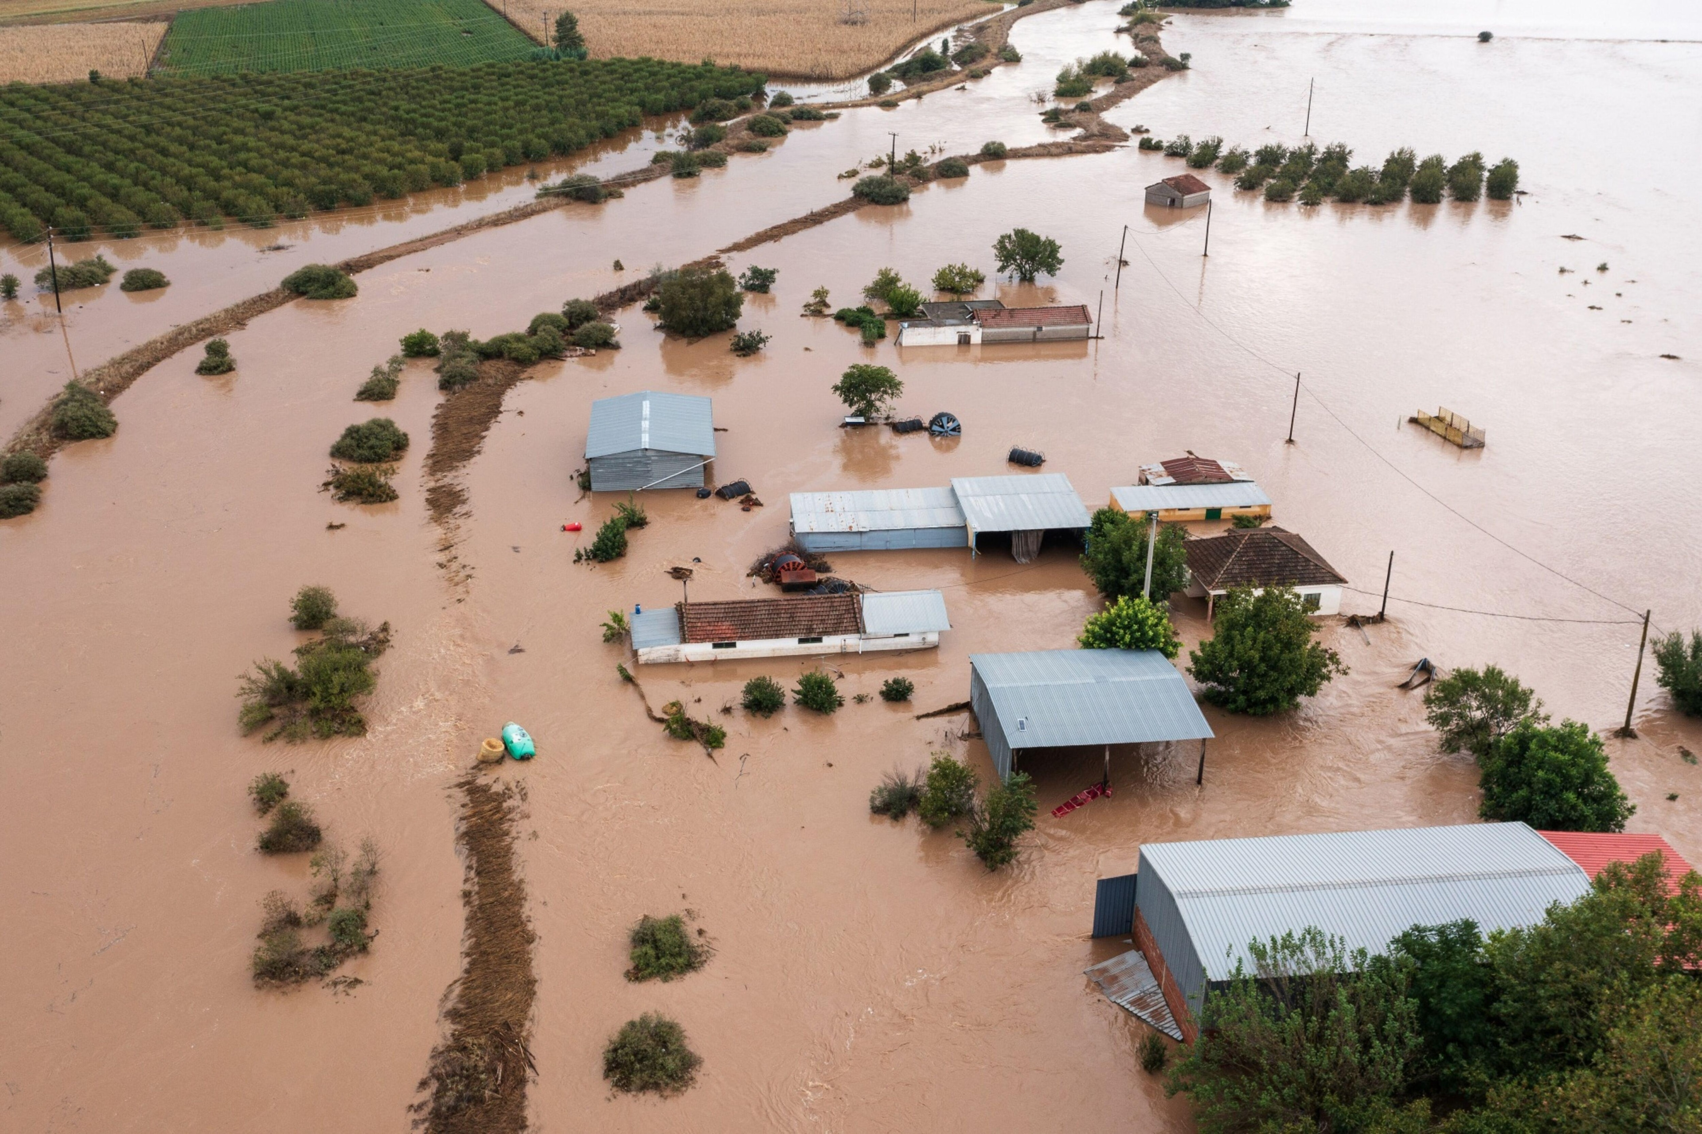
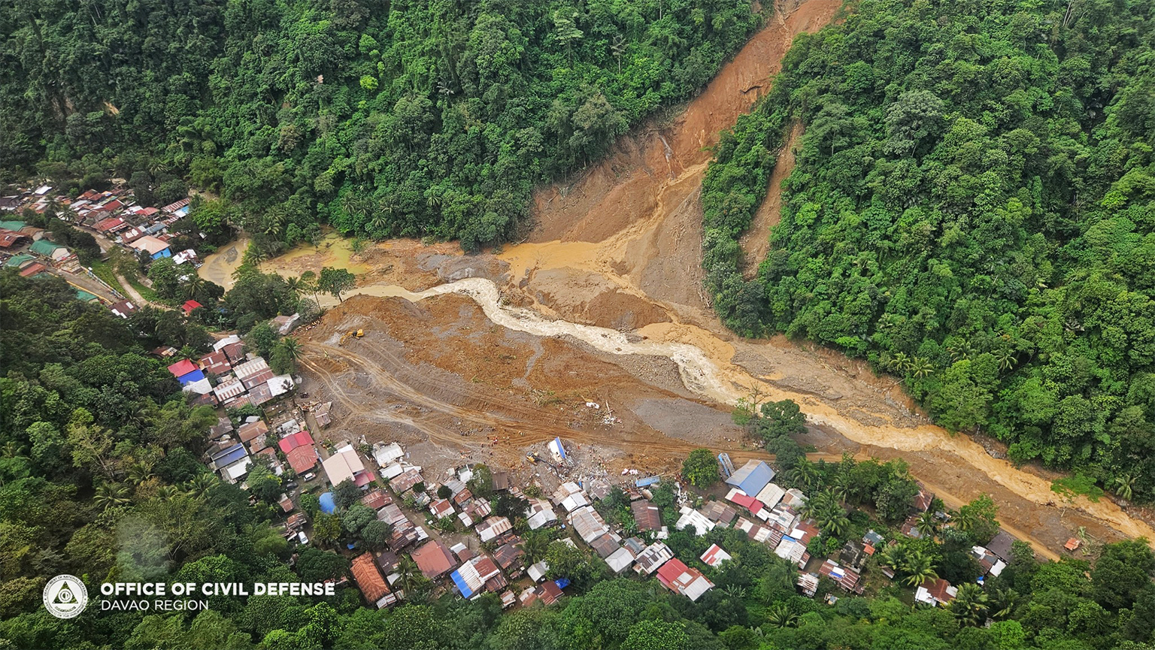
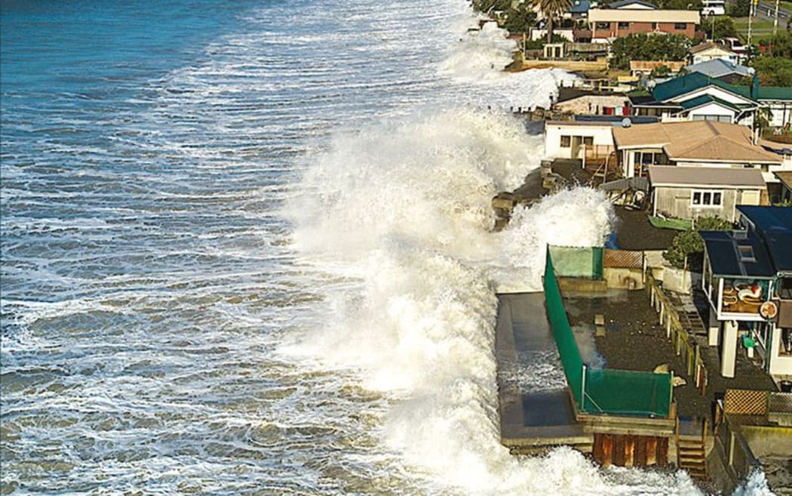
Esmeraldas is a costal city under multiple disaster risks, including floods, sea level rise and landslide
Floods in the costal area, especially the Esmeraldas city
Floods:
The Esmeraldas river (4th largest in Ecuador) and the Teaone river crossing along the residential area.
The area is very humid, annual rainfall in the city is about 800 mm. Frequent overflow of the 2 rivers is the direct cause of floods in this area.
Tachina Airport
All disaster risks are strongly correlated with the precipitation within the river basin. So, the key to prevent the damage of disasters is to forecast the level of precipitation and river level so that we can warn the public in time.
Landslides
Cerra Gatazo is a 260 m height hill that divides the city into two parts
The slopes are a mixture of eroded and barren areas and vegetated areas with grasses and trees.
Despite the high risk, the local population occupied the hill land informally and illegally.
Sedimentary Island
Cerra Gatazo
Sea level rise:
Sea level rise could make up to 6% of the city under water
The sedimentary islands and Tachina Airport would be the most affected areas.
Notes:
Under the influence of el nino. This area is becoming more and more humid

Slide 4
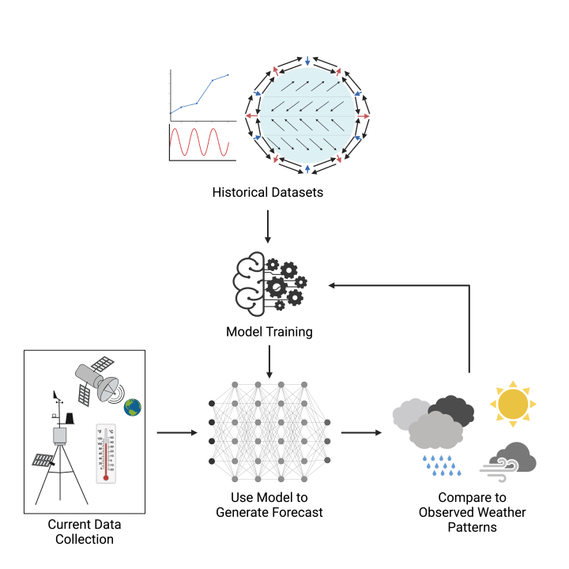
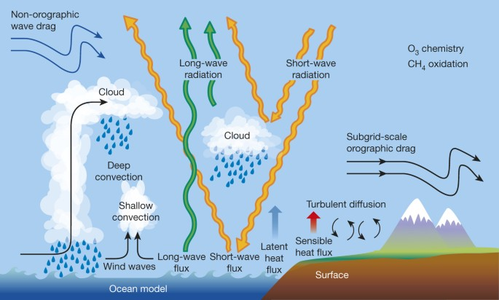
Approach: To provide timely and accurate forecasts of extreme precipitation with limited resources, we turn to AI
From traditional numeric model
To data-driven AI model
Simplified modeling with mature practices proven to work, no background knowledge required
Strict requirement of multiple sources of meteorological data collection
Complicate modeling base on discipline of traditional physics to include every variables
Deductive nature of the model with integration calculation
High consumption of computing power and slow computation speed due to complexity of model
Notes:
Explain why did we make the transition from numeric (abstract the natural climate process and turn them into equations and models) to data-driven
From the input to the output, Too many parameters and process to include and simulate
From the output to the output, just let AI do the learning of the output, no need to understand the principles of the climate process
More efficient and easy

Slide 5
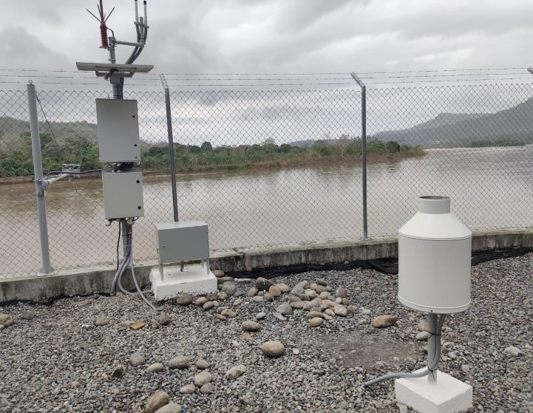
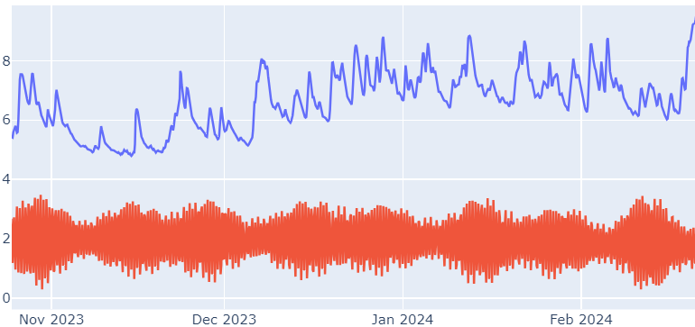
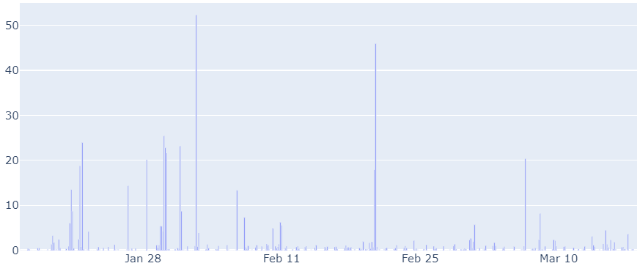
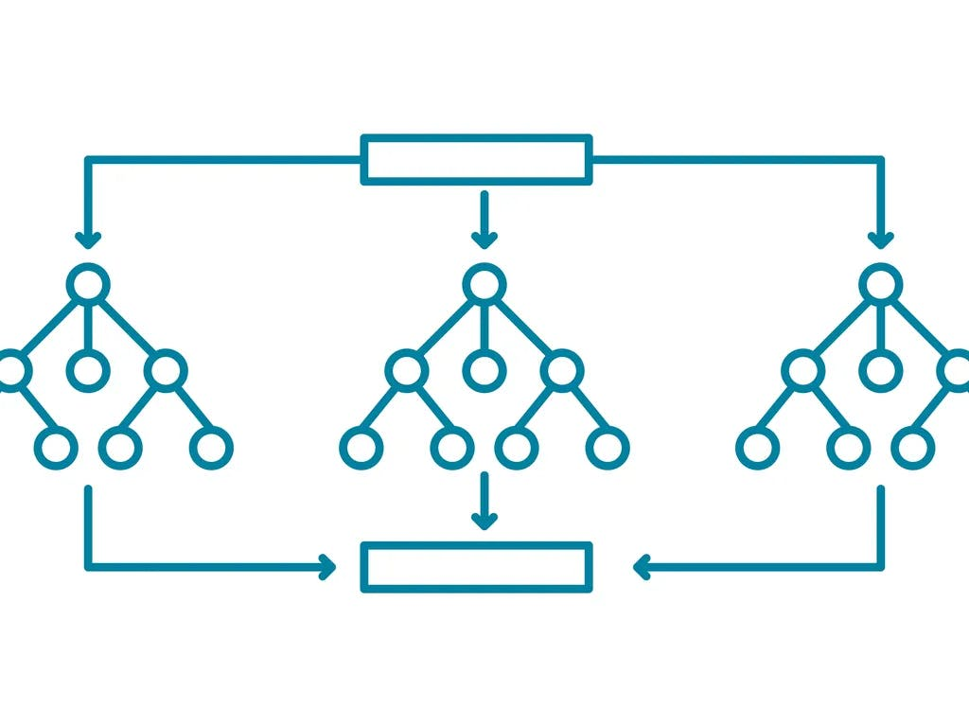
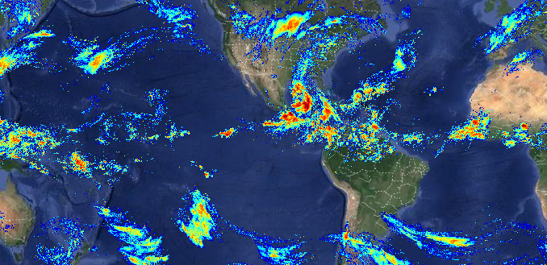
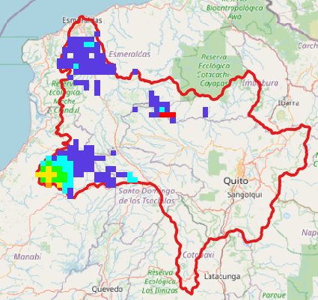
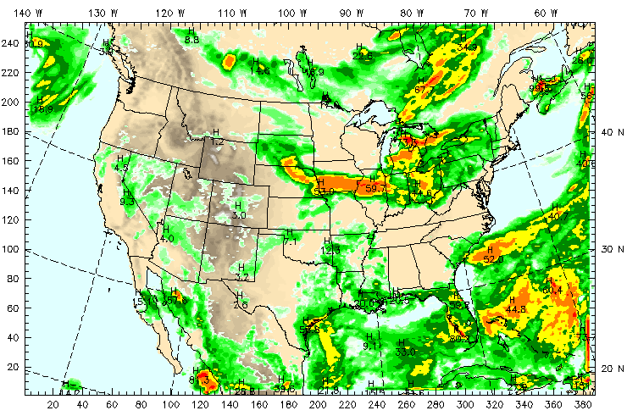
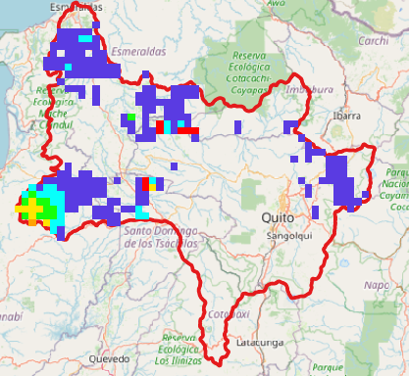
Given limited number of available X variables, we involve inputs from other models to enhance the model’s Capacity
Historical data input
Vector of features
AI model
Bulletin generation
Physical sensor deployed by CAE
3+1098+2416 = 3517 features
Random forest
Frequency: every 3 hours
Y
X_1
X_2
…
The water level at San Mateo
3*1, with the lagged entries from the data of the 3 sensors deployed in Esmeraldas. Lags determined by PACF.
t - 24
WRF data of time t ready
PERSIANN-CCS: rainfall estimation based on satellite infrared images of cloud-patchs, by UC Irvine
1098*1, accounts for all the valid pixels make up of the Esmeraldas river basin. Different clusters of pixels are subject to different lags considering the arrival time of precipitation
Y: the water level at the San Mateo station
t – 2.5
Lagged sensor data required of time t ready
t – 1.5
CCS data required of time t ready
WRF
2416*1, accounts for all the valid pixels make up of the Esmeraldas river basin. Different resolution with the CCS data.
t
Fit the forecasted result and upload to the data portal of INAMHI. If triggered certain threshold, bulletin generated.
Notes:
Not only with the limited sensor data, we’ll have to include more sources of input data to enhance its performance.
By combining satellite cloud image data from open sources, we in total collected more than 3000 features for the AI model to learn.
Due to the enormous number of features, we choose random forest as the model to interpret the input.
With the trained model ready, we can input new entries of feature at a 3hourly frequency and produce our forecast accordingly.

Slide 6
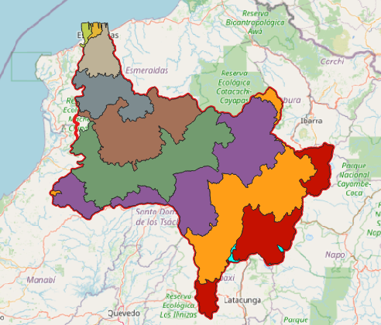
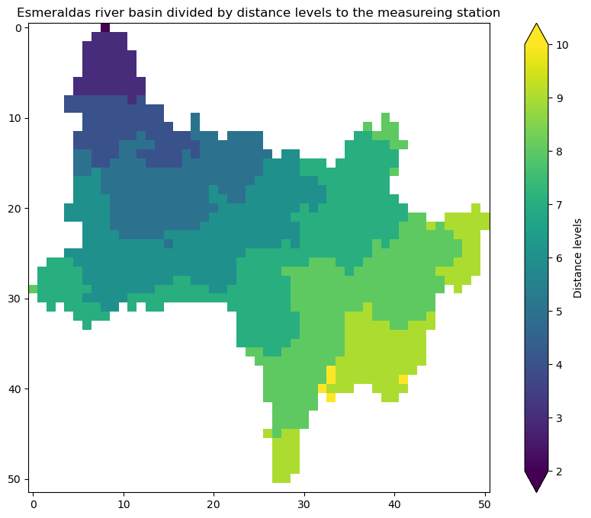
To further enhance the accuracy of the model, we have to consider the different arrival time of the precipitation with different distance
Hydrological distance division according to INAMHI
Applying distance clustering to the pixels
Esmeraldas sensor station
Esmeraldas sensor station
Lag 1: t-3
Lag 2: t-6
Lag 10: t-30
……
Pixel 1 | Pixel 2 | …
Feature Vector
Notes:
But we can’t ignore some basic hydrological nature and just feed the data to the model blindly. Mostly it will be garbage-in-garbage-out. To filter the garbage, we combine the hydrological computation with the features, to include the dimension of time into the satellite data. We divide the Esmeraldas river basin into 10 different segments according to their hydrological distance to our target point of prediction – the San Mateo station.
Intuitively, the further the precipitation is, the later it would affect the river level at its lower basin.
According to this division of basin, we divide the pixels of cloud image to 10 groups. We use different lags of those groups accordingly to construct the features.
In this way we can make sure the features we feed to the model is reasonable.

Slide 7
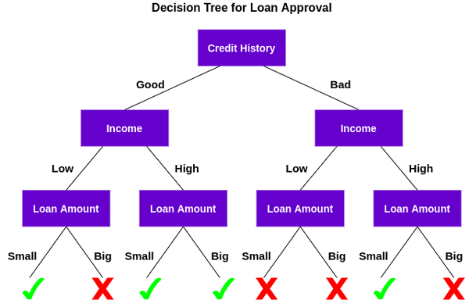
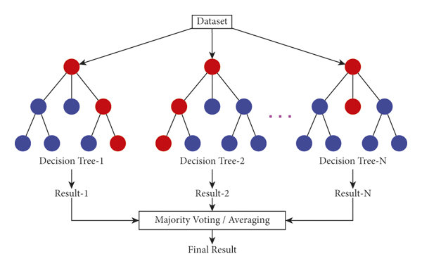
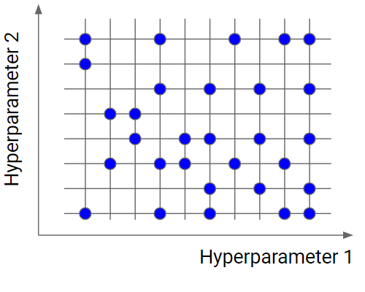
Random forest becomes our primary choice of AI model given its strong capability dealing with multiple features and efficiency of computation
Model
Hyper-parameter
Random forest is a set of different decision-trees
Each decision tree contains different features and input data
We use random forest as the primary structure of our AI model
It’s easy and fast, given limited computational resources
Example hyperparameters of the model: number of trees in the forest, max number of levels in each decision tree, etc.
Before the actual training, we need to conduct grid search to determine all the hyper-parameters
Notes:
To demonstrate: how do we determine the value of the lag?
To illustrate the fundamental idea of decision tree. Why do we choose it?
After we construct the features, we have to feed the features into an AI model to let it learn from the past and help us to predict the future.
Among all the sophisticated models we chose random forest.
A random forest is made of multiple trees, and they are actually decision trees. If you don’t know what is a decision tree, in this graph, each level represents a feature, and we consider all the features level by level. If we have multiple decision trees sampled randomly, then we formulated the random forest.
It’s like asking multiple experts about the same problem: what the river level at San Mateo will be in 3 hours? Each decision tree is given randomly sampled features to consider (because we have more than 3000 features, it’s a good way to reduce the complexity of computation), and with randomly chosen samples for reference. At the end, we consolidate all the prediction results by multiple experts together to get the final outcome of our model.
But during the training of random forest, there are lot of hyperparameters to be decided. For example the number of trees and the maximum of levels of each tree, for these hyperparamters, we have to conduct a grid search of each combination of those parameters, which makes the training take much more time than a single training.

Slide 8
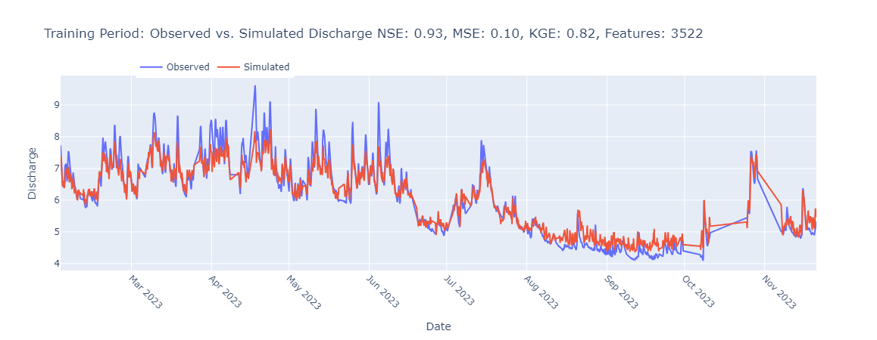
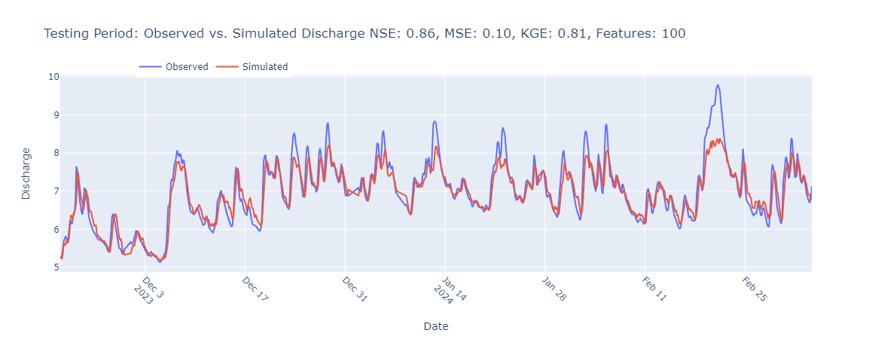
Training and testing results show ideal performance of the model but it still needs further adjustment to capture the extreme occasions
Training
Testing
Notes:
After we found out the best combination of hyperparameters, we apply the model with this specific set of parameters to receive the test set data. And here we can tell that the simulated curve fits the general trend with the observed curve, but sometimes it fails to capture the extreme case. Like here for February of this year. So this is also the direction the model could further improved in the future. Since we are working in the risk reduction field, we are supposed to care more about the extreme case where the risk is more likely to be.

Slide 9
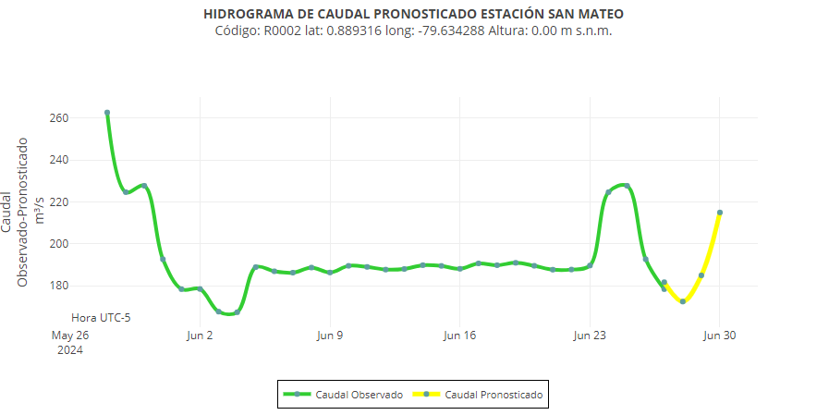




With the trained model, we can integrate the real-time data fetching process together to realize accurate and timely nowcasting
Current forecasted result has already been integrated with INAMHI’s visor system
Next step to apply the forecasted result to the early warning system to generate bulletins in advance
Generate warnings in advance
Notes:
After finishing the coding of this model itself, it’s even more important to make it accessible and easy to use. If no one uses this model or no one looks at our forecasted result, all the work we done would be meaningless.
So we further embedded the result of this model into the previous visor system, so that it could offer reference to the public.
But we still need to develop a bulletin generation scheme and try our best to make the useful information to be heard by the beneficiary public.

Slide 10
Limitation of the current approach and future challenges
Lack of data input in terms of both time and space dimension:
Insufficient range of historical data for only 1 year
Limited number of sensors deployed in the area
More sensors to be deploy in the region and maintain the performance and reliability of the existing sensors
Deficit from the simple data-driven model
Constrained by the computational power, simple random forest was chosen, which makes the model itself tend to be conservative, hard to capture the extreme situation
Try more sophisticated AI model with stronger computational power
Better to combine with the current numerical model to improve the accuracy
Low error-tolerance. Once the sensor failed and it didn’t receive the data, the model can’t make the prediction accordingly
Maintenance of the model and relative assets
Maintenance and updating of the model itself requires capability of data manipulation and AI engineering background
Operation and maintenance of the existing sensor stations involve multiple stakeholders, easy for disorder and confusion to occur

Slide 11
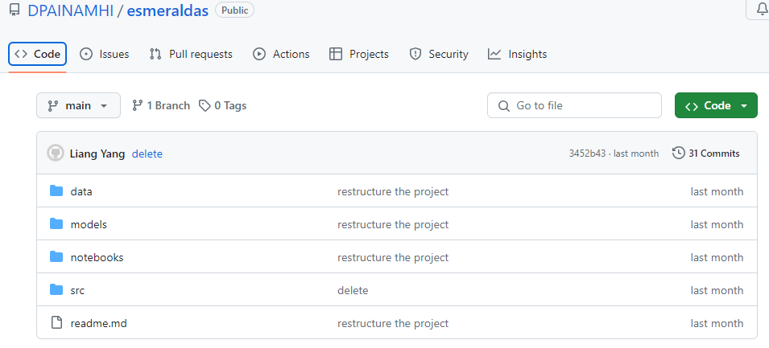
Productions of work compiled into INAMHI’s Github repository for future development and maintenance
https://github.com/DPAINAMHI/esmeraldas
Notes:
It has been a very different 6 months in term of experiences, we have encountered and conquered a lot of difficulties to make the project look like what it is today. At the beginning, there is some miscommunication, so I didn’t work directly to this model, which wasted me some time. But after I started to work on this model, thanks to the help from both my colleagues of PNUD and those from INAMHI, I could learn a lot of new things and get these hands-on experience to develop something from scratch. Although there are still some existing problems and limitations, I believe it will be a helpful cornerstone of this project and contribute to the improvement of people’s life in Esmeraldas.

